Slide 1
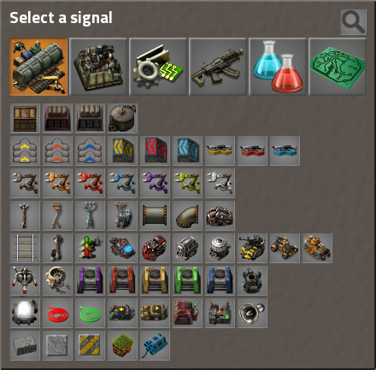
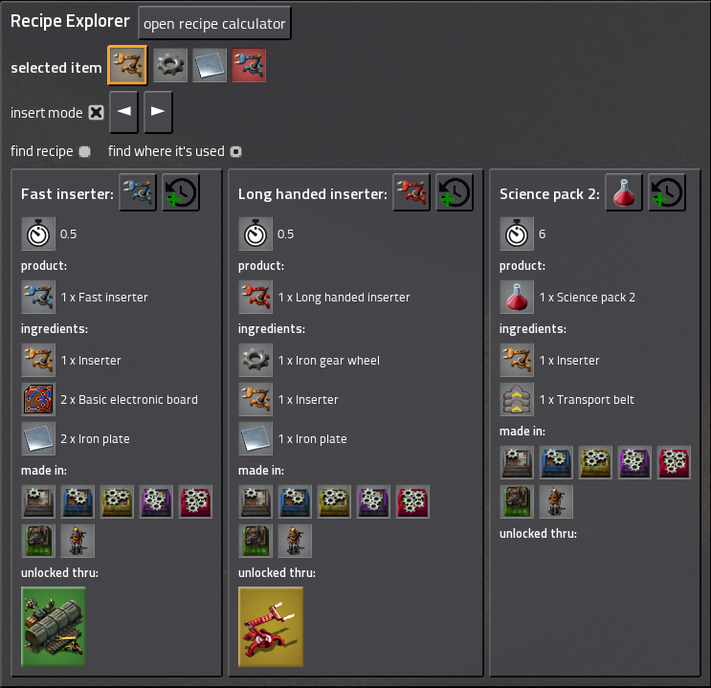
Recipe Explorer
Open and close with Ctrl + F
1
3
Select your item in a familiar interface.
Choose if you want find a recipe or find where the item is used.
Browsing thru your previous selected items.
Click on a product in the recipe to find out where it’s used.
Click on a ingredient in a recipe to find out how it’s made.
Find out where you can use the recipe and click on it to find the recipe for the processing machine.
Craft directly your items. (LMB = 1x, RMB = 5x)
Copy paste your recipe directly in your processing machine. (click and select area)
See directly if and which technology you need to unlock. Click on it and see the technology directly in the research tree (experimental feature).
2
8
10
4
5
6
7
9

Slide 2
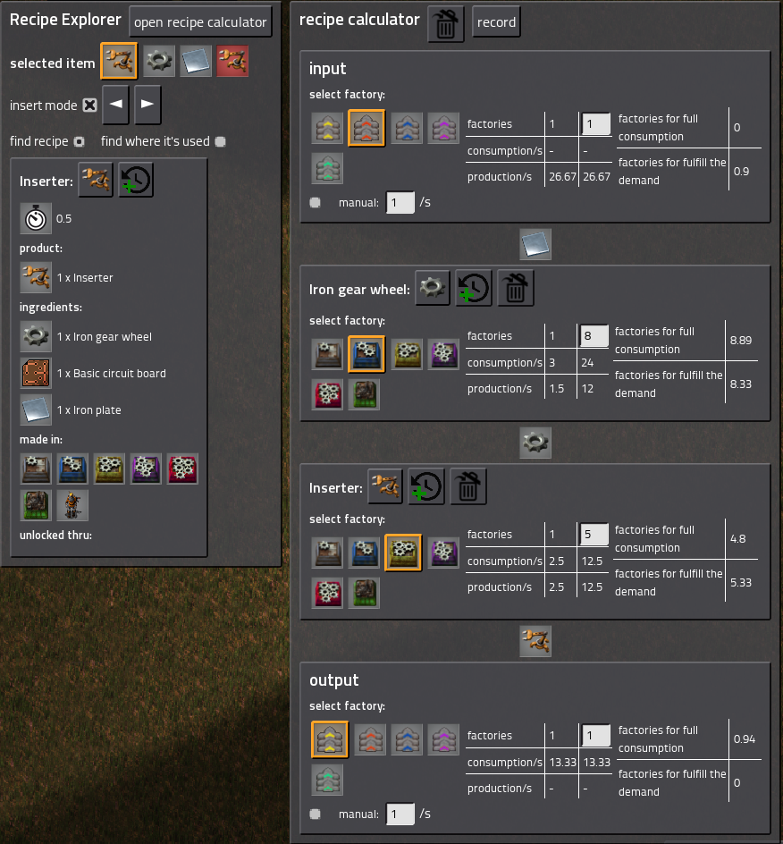
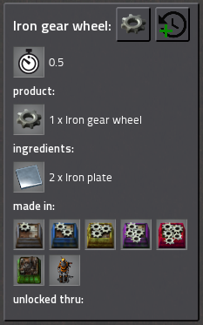
2
1
Recipe calculator
9
11
Open and close recipe calculator
Activate recording: When it is recording it will record your selected products and ingredients and will add the recipe to the calculator.
Select the ingredient you will produce for this recipe.
You can do this over multiple level of recipes
RMB = select the Factory in witch the recipe is produced LMB = will display the recipe for the factory
Will display how many factory are required for full consumption of all products of the previous factory,
Will display how many factory are required to produce all the products to fulfill the demand from the factories in the production chain.
Set the amounts of factories you will use for this recipe.
The output and Input are like virtual factories witch simulate the production chain requirements. If no product is on the beginning/end you need to select a product in the recipe on the beginning/end of the production chain
Select witch type of transport belt you use. Only available when the product on the beginning/end of the product chain is a item
Select how many belts full of items you will have as input/output
10
8
3
6
5
7
8
4
9
11
10

